Slide 1

Machine learning algorithms to analyze water consumption patterns and provide conservation suggestions.
Presented by Pro-decoder

Slide 2

Idea of problem
Analyzing water consumption patterns and providing conservation suggestions using machine learning algorithms can be a valuable tool for managing and optimizing water resources. Here are some machine learning algorithms and approaches you can use for this purpose

Slide 3
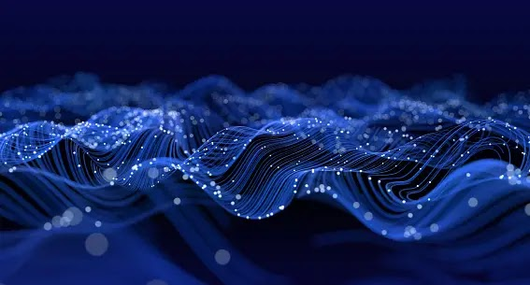
Linear regression
Linear regression can be used to model the relationship between various factors (e.g., weather, population, time of day) and water consumption. It can help identify trends and correlations in the data.

Slide 4

Time Series Analysis
Time series analysis techniques, such as ARIMA (AutoRegressive Integrated Moving Average) or Prophet, can be used to forecast future water consumption based on historical data. This can aid in predicting demand and planning resources accordingly.

Slide 5

Decision Trees and Random Forests
Decision trees and random forests are useful for feature selection and classification. You can use them to identify the key factors that influence water consumption and classify consumption patterns for targeted interventions.

Slide 6
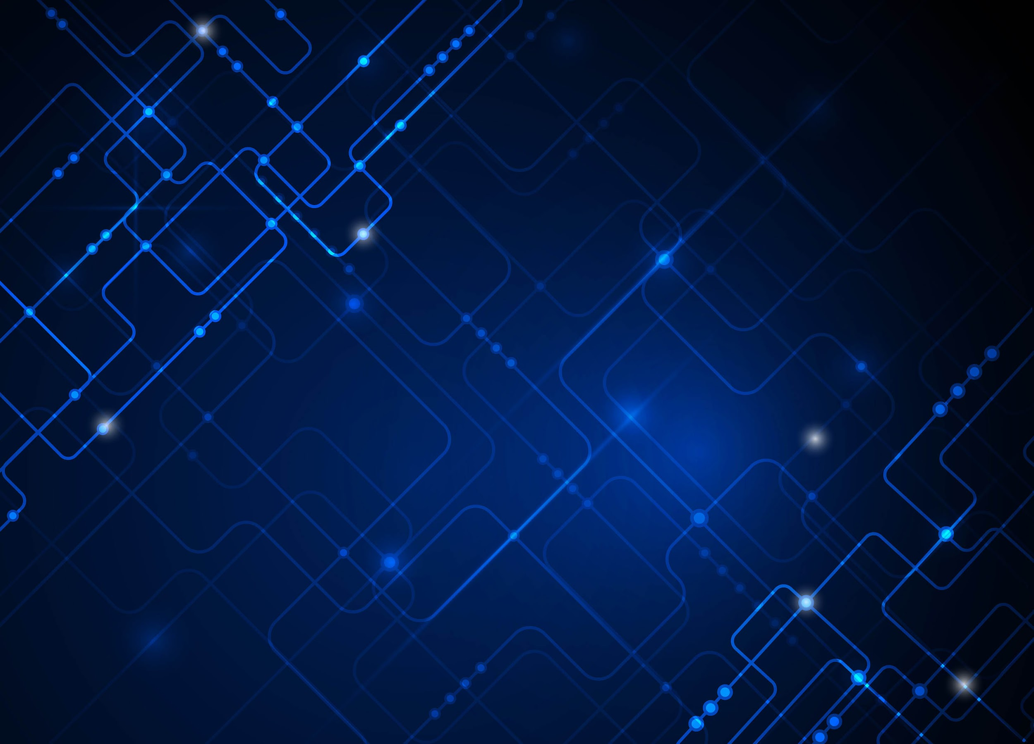
Neural Networks
Deep learning models, such as neural networks, can be employed for complex pattern recognition. They can analyze large datasets and discover intricate relationships between variables that might not be apparent through traditional analysis.

Slide 7

Clustering Algorithms
Clustering algorithms like K-Means or DBSCAN can segment customers or regions based on similar water consumption patterns. This can help tailor conservation strategies to specific groups.

Slide 8
Anomaly Detection
Anomaly detection algorithms can identify unusual spikes or drops in water consumption. These anomalies may indicate leaks, malfunctions, or other issues that require immediate attention.

Slide 9

Reinforcement Learning
Reinforcement learning can be used to optimize water resource management in real-time. Agents can be trained to make decisions, such as when to release water from reservoirs or adjust water treatment processes, to minimize waste and maximize efficiency.

Slide 10
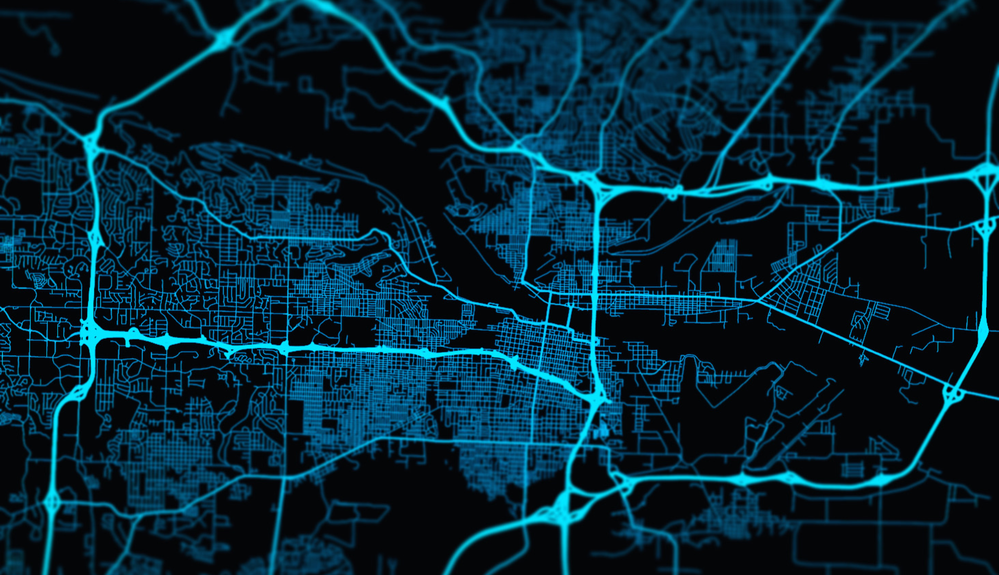
Geospatial Analysis
Combine machine learning with geospatial data to analyze water consumption patterns across different geographical areas. This can help in identifying regional variations and targeting conservation efforts accordingly.

Slide 11
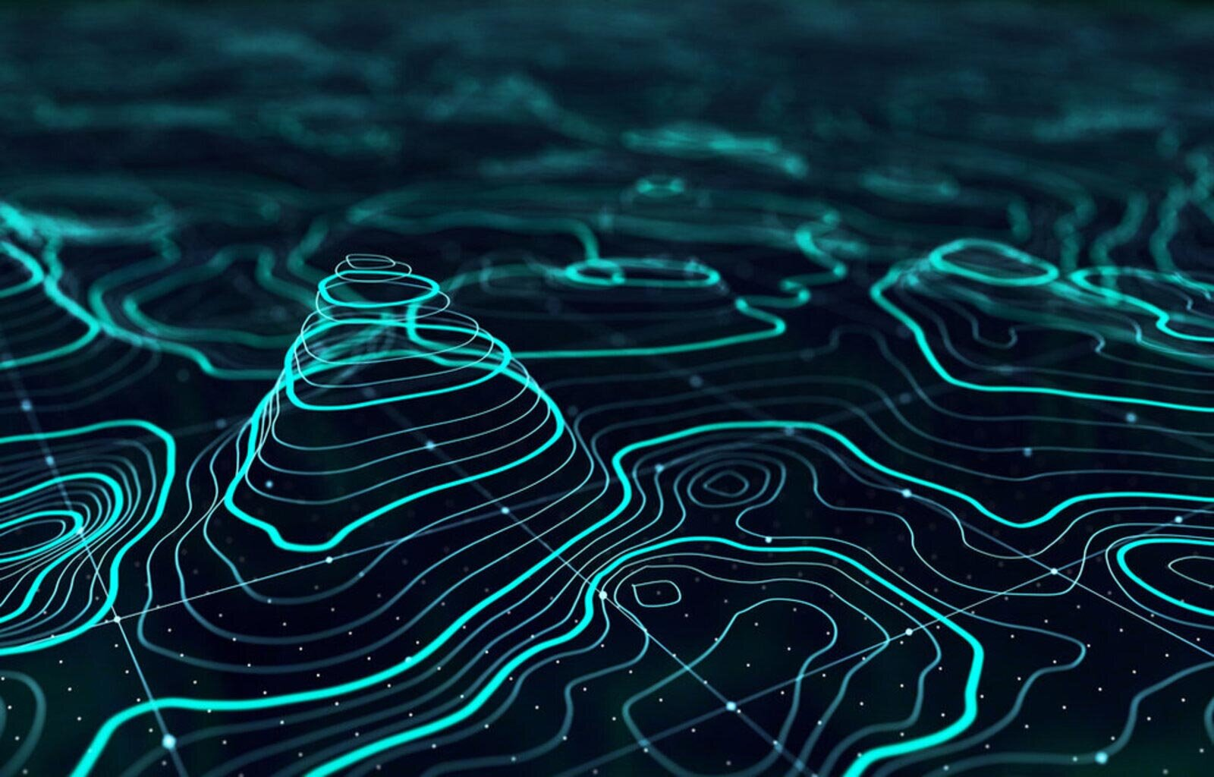
Natural Language Processing (NLP)
NLP can be used to analyze textual data, such as customer feedback or reports related to water usage. It can help extract valuable insights and suggestions for water conservation.
Recommendation Systems: Build recommendation systems that suggest water-saving tips and practices to individual users or businesses based on their consumption patterns and characteristics.

Slide 12
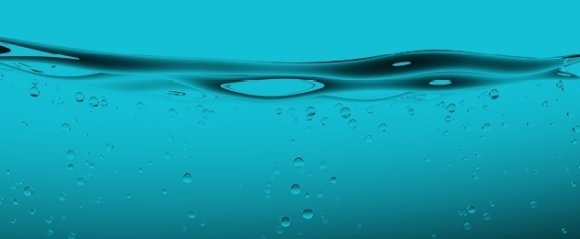
Water conservation suggestion
Fix Leaks: One of the most significant sources of water wastage is leaks in faucets, pipes, and toilets. Regularly inspect and repair leaks to prevent water loss.
Upgrade to Water-Efficient Appliances: Replace older, inefficient appliances like washing machines and dishwashers with WaterSense or ENERGY STAR-rated models that use less water.
Install Low-Flow Fixtures: Install low-flow showerheads, faucets, and toilets to reduce water consumption while maintaining water pressure and functionality.
Collect Rainwater: Install rain barrels to collect rainwater for outdoor use, such as watering plants and gardens.
Water Plants Wisely: Water your garden or lawn early in the morning or late in the evening to minimize evaporation. Use a soaker hose or drip irrigation to target the roots directly.

Slide 13
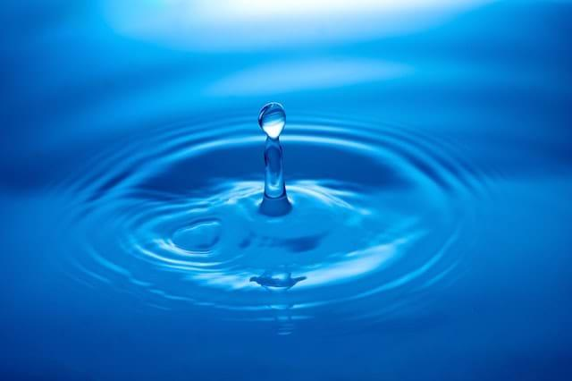
Xeriscaping
Xeriscaping: Consider xeriscaping your yard with drought-tolerant plants that require less water.
Use a Pool Cover: If you have a swimming pool, use a pool cover to reduce water evaporation.
Harvest Greywater: Install a greywater system to reuse water from sinks, showers, and laundry for non-potable purposes like flushing toilets or watering plants.
Regular Maintenance: Maintain your water-using appliances and fixtures to ensure they function efficiently.

Slide 14
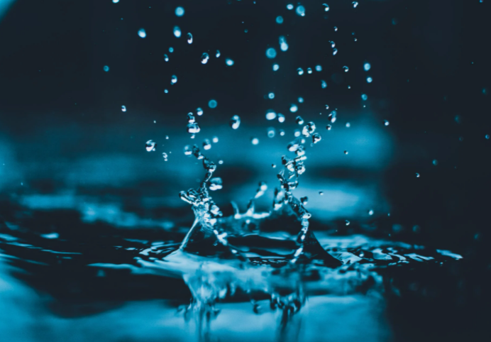
THANK YOU

